Slide 1

The Life course of a Computational Sociology Research Project
Alina Arseniev-Koehler and Bernard Koch

Slide 2
Outline: 3h
25 min Concepts and Example CompSoc Projects
20 min Developing your CompSoc Project Workflow
15 min break
Remainder (~2h): Data Wrangling in Python (hands-on)

Slide 3
Storing and Managing Data
Always keep a raw version if permitted by IRB
Ideal workflow is transparent, replicable, efficient
Do as much cleaning with code rather than Excel/by hand
Use Github!
*maybe, design as a tutorial ☺
Use Box!
Think carefully about how to name your data files (e.g., by year? by ID?)

Slide 4
Raw
Data Key
ID | Birthdate | Gender | Depression | Notes
104 | Sep 1992 | M | 3
241 | October 1998 | F | 6
125 | 999 | 999 | 13
347 | 04/1995 | M | 16
835 | September 1993 | F | 0
Variable | Description
ID | ID# of participant
Birthdate | Birthdate of participant. Missing: 999
Gender | Male, Female. Missing: 999
Depression | Depression Score, According to PHQ-8. Ranges from 0 (low risk of depression) to 24 (high risk of depression). Missing: 999.
Notes | Any notes.
“Raw” means something different for each analysis/research project. CSV vs XLS
Notes:
DETAILED data key. Add in as much as possible! When you create a new variable, add to data key as well (unless you explain in the code)

Slide 5
Clean
Data Key
ID | Age | Gender | Dep_Score | Dep_Binary | Notes
104 | 26 | M | 3 | 0
241 | 20 | F | 6 | 0
125 | 999 | 999 | 13 | 1
347 | 23 | M | 16 | 1
835 | 25 | F | 0 | 0
Variable | Description
ID | ID# of participant
Age | Age (years) of participant. Missing: 999
Gender | Male, Female. Missing: 999
Depression_Score | Depression Score, According to PHQ-8. Ranges from 0 (low risk of depression) to 24 (high risk of depression). Missing: 999.
Depression_Binary | Has depression risk or not (0/1), according to PHQ-8. Score >9 on PHQ suggests depression risk. Missing=999.
Notes | Any notes.
“Clean” means something different for each analysis/research project

Slide 6
Thinking about the production of data
Where do your variables come from? (e.g., “depression score”)
Some social science/health abstraction from psychiatrists abstraction of latent mental distress
Continuous vs binary
How was the data collected/produced?
E.g., self report vs interview (interview with human or with virtual agent?)

Slide 7
0 or 1: “Depression” or not
Thinking about the production of data
“Depression”
Self-Report Measure, e.g. PHQ
Psychiatrists’ Evaluation
Depression (latent)
Notes:
In computational modeling, labels are
often treated as the objective truth.
They are the gold-standard a model seeks to match, and
against which errors are compared. This places
tremendous confidence in these labels, particularly
when they are binary measures of mental well-
ness or illness. However, these labels have their
own back-story in which they are created and recreated
Most studies detecting depression use labels
from self-report diagnostic scales, such as the
PHQ. Implicitly, these scales are proxies for psy-
chiatric ratings from structured interviews. Of
course, they are an imperfect proxy.
-----
For example, in an original validation study for the PHQ-
9, the PHQ-9 reaches 88% sensitivity compared
to mental health professionals’ ratings
Rates are more like 77% in
subsequent validation studies . That means that just over ¾ of the people with depression are categorized as “depressed” according to the PHQ.
-------
So, even an algorithm
which perfectly predicts PHQ scores from lan-
guage,, likely has a wide margin for er-
rors for detecting depression when compared to a
mental health professional rather than the proxy
measure on which it is trained.
In other words, layers of uncertainty across a process of label-making are compounding uncertainty , and this uncertainty is often swept aside.

Slide 8
Abstracted variables vs human experience
“I can’t even fathom joy”
“yup, uh, I was diagnosed with depression a long while back, i guess it’s one of those things that you gotta keep in check throughout your entire life”
“0” or “1” for depression
“it…it…it's like everyone can just tell and i'm just a time bomb of sadness”
*Data excerpts are not verbatim for word for privacy reasons; they are heavily modified versions represent the kind of language used in these interviews with individuals about their depression experiences
Notes:
Low dep, no dep, low dep,
One participant believes their best
friend would describe them as happy, but scores
nearly at the maximum value for depression on the
PHQ-8.
Another participant mentions
I can’t even
fathom happiness,
while reporting a PHQ-8 score
just above the cutoff for mild depression: qual-
itatively and quantitatively these two reports tell
different stories.
SOME people respond “0” because of stigma or self-presentation, etc. but really no symptoms of mental distress, ever??
e see other types of mismatches between lived
experiences of depression and quantitative repre-
sentations of depression as well. For example, an-
other participant in our study - who is not cate-
gorized as currently depressed based on the PHQ-
8 - says,
yeah i’ve been diagnosed with depres-
sion once so i feel like it’s one of those things that
uh is something i have to keep in check through-
out my entire life.
It is possible that this partici-
pant is not categorized as depressed precisely be-
cause they are successfully
managing
depression.
Quantitatively and qualitatively these are telling very different stories. This might be due to social desirability and social stigma in reporting mental health, indeed nearly 20% of our participants report a 0 on the PHQ, which, intuitively feels unrealistic. Or perhaps this happens because the PHQ is a measures of current depression, while we know that depression cycles and commonly recurs. And, we also know that linguistics patterns vary across the trajectory of a depression experience, suggesting linguistic patterns of depression might be better examined longitudinally than cross sectionally.

Slide 9
Missing Data
No crystal-clear rules about how to deal with, but important
Types: missing completely at random, missing at random, missing not at random
Most models assume no missing data/missing completely at random
Always:
check how much is missing
relationship of missingness with other variables
Some imperfect solutions:
Impute (e.g., predict missing values, mean imputation, etc.)
Delete

Slide 10
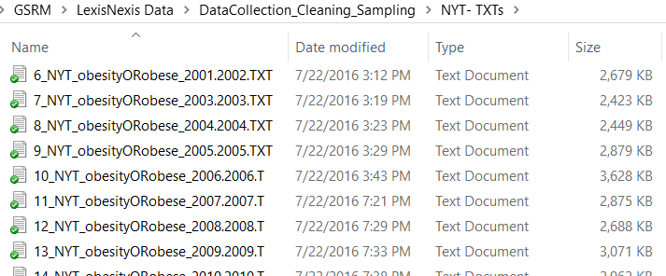
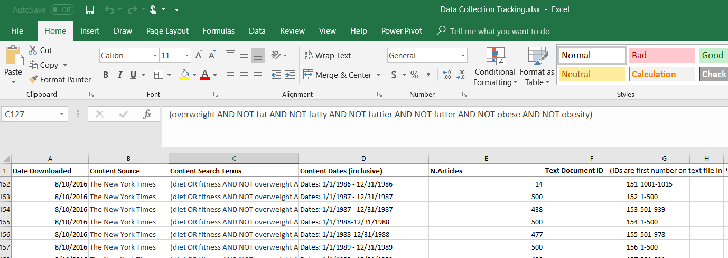
Raw vs Clean: Text mining example
RAW: ~245 .txt files with 100k articles Excel notes while collecting articles:
Sample data: “I flew a KITE. I flew it yesterday! It was pretty fun.”
“Cleaned” for Word2Vec algorithm:
sentences= [[i, flew, a, kite], [i, flew, it, yesterday], [it, was, pretty, fun]

Slide 11
Feature Engineering
Sometimes, too much data! (or noise). Or, you want to create a new variable from existing ones
From theory, previous empirical research (e.g., depression as binary)
Traditionally, feature engineering was secret sauce to most of data science
Contrast feature engineering with dimensionality reduction/learning features, which is inductive (next)

Slide 12
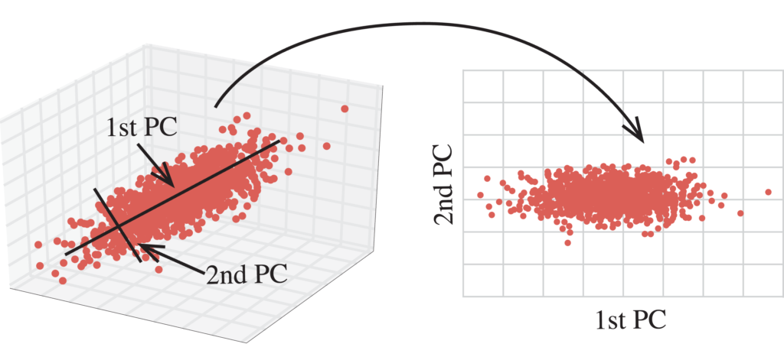
Dimensionality Reduction
Let an algorithm learn the important features
Reduce with:
Principal Component Analysis, Singular Value Decomposition, etc.
Image: http://blog.kaggle.com/2017/04/10/exploring-the-structure-of-high-dimensional-data-with-hypertools-in-kaggle-kernels/
Notes:
IN general, you try to predict a data point from the data around it, and if you get a large error, then this might be an anomaly!
Ex, try to predict a point form the other points in its same cluster – if you can’t predict it maybe it is an anomaly!
There are other types of unsupervised learning as well, that we won’t cover (dimensionality reduction)

Slide 13
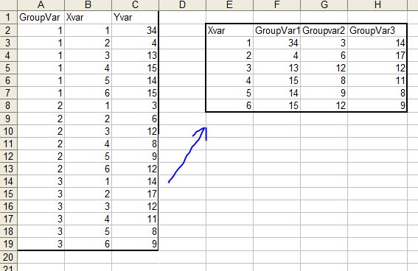
Long vs Wide Data

Slide 14
Merging Data
ID | Age | Gender | Dep_Score | Dep_Binary | Notes
104 | 26 | M | 3 | 0
241 | 20 | F | 6 | 0
125 | 999 | 999 | 13 | 1
347 | 23 | M | 16 | 1
835 | 25 | F | 0 | 0
ID | Twitter_bio_Descript
104 | “
241 | 999
125
347 | 999
835 | “Happy”
ID | Age | Gender | Dep_Score | Dep_Binary | Notes | Twitter_bio_Descript
104 | 26 | M | 3 | 0
241 | 20 | F | 6 | 0
125 | 999 | 999 | 13 | 1
347 | 23 | M | 16 | 1
835 | 25 | F | 0 | 0

Slide 15
Getting to know your data vs fishing
What’s the difference?
The importance of “hanging out with your data”
Read, manually
Descriptive summaries (e.g., tables, cross tabs, frequencies)
Visualizations (may be deceptive!)

Slide 16
Replicability
What’s the issue?
Statistical significance is socially constructed
File-drawer issue
Types of replicability
Can the research be replicated on the same dataset? (but code/resources change…)
Is it replicable (generalizable) to other data sets? (but society/ppl change…)
Pre-registration
Inductive vs deductive?
Triangulation vs replication
Open-source code, detailed appendices, ideally open source data
Notes:
BUT, its hard even to make a single project replicable on the same data set (e.g., Python libraries/code keeps changing)
Also, hard to make findings replicable across time/contects (e.g., people and society just change! Doesn’t mean original findongs were incorrect, just specific to that contecxt

Slide 17

Measuring model performance
Errors and outliers
Accuracy rates of models to “detect depression” from language: >90%*
What is the most costly error? Who are the errors?
 | Has Depression | No Depression
Depression Detected
No Depression Detected
“Accuracy” according to algorithms vs psychiatrists
Notes:
A great deal of research goes into assessing the
performance of predictive models. There are F1
scores, accuracy rates, recall, ROC curves, pre-
cision, and root mean-square error, among other
measures
Most research reviewed
in this paper do not explicitly discuss of which
measures they prioritize, and some just look at raw accuracy rates.
In most mental health contexts, the worst type of error
error is to miss an individual with depression.
Thus, models should prioritize on minimizing this type of error.
Other types of errors, might matter less, however, for example it is not such a a bad error to categorize someone as depressed who does not have depression.
It may be fruitful to compare clinicians’ diagnostic practices with computational models. One study did so and found that tend to miscategorize those without depressopmn, m,odels tended to miscategorize those with depression.
These assumptions are implicit and often very buried in models, and depend a great deal on the person developing the model.
-----
The psychologists’ sensitivities to
the BDI (.83, .83, and .66 respectively) were far
higher than the models (average of .50), while
their precision was far lower than models (.38, .33,
and .33, respectively among raters, and average of
.47 among models). Perhaps part of this sensitiv-
ity is humans’ tendency to heavily weigh evidence
for
Further, as also noted by Guntuku et al.,
an issue with sensitivity is that it depends on the
prevalence of a condition. Thus sensitivities of
a model are difficult to compare across datasets.
In medicine, another commonly used performance
metric which addresses this issue is positive pre-
dictive value. And, like practices in medicine,
modeling efforts might consider using a single
model across various populations to understand
how it generalizes to new, unique groups of peo-
Ple.

Slide 18
Sample 3 CompSoc Project Workflow (Alina)
Time | Activities
Winter 2015 | Interested in Word2Vec (Jacob suggested) Read about it online
Spring 2016 | Idea: How is obesity portrayed in news? Method: Word2Vec language model Data: New York Times, from Lexis Nexis
July-August 2016 | Collect 100k news articles from LexisNexis. Struggle to clean (~2 months).
August-Sept 2016 | Mess around with Word2Vec on news a LOT, seemed promising. Read about obesity/news.
Winter 2016 | Presented Word2Vec to CompSoc
Fall 2016-Spring 2017 Spring: MA Thesis due | Narrow RQs. Test out with Word2Vec/news data Check robustness many times, get confused many times, make visuals in R Wrote up results (theory still vague)
Spring 2017-Spring 2018 | Revise paper, theory, more robustness checks, ideas for next projects
June 2018 | Prettify code, put on Github, Present to CompSoc
Now: | Minor revisions, submitting for peer review
Throughout: | Reading, getting confused, etc.

Slide 19
Sample 3 CompSoc Abstract (Alina + Jacob)
Over half (64%) of Americans want to lose weight; eating disorders and weight-based discrimination run rampant. These overwhelmingly negative conceptions of fat are often attributed to media influence, suggesting this is a process of cultural learning. But it remains unclear exactly how public culture becomes private culture.
We provide a computational account of this cultural learning, showing how schemata about obesity can be learned from news reporting. We extract these schemata from New York Times articles with Word2Vec, a model that learns language in ways that are inspired by our own cognition. We identify several cultural schemata around obesity, linking it to femininity, immorality, poor health, and low socioeconomic class.
Such schemata may be subtly but pervasively activated by our language; thus, language may be one vehicle for the reproduction of biases around body weight and health. Finally, findings validate concerns that machine-learned algorithms may encode, and reproduce, negative biases.
Notes:
Over half (64%) of Americans want to lose weight; eating disorders and weight-based discrimination run rampant. These overwhelmingly negative conceptions of fat are often attributed to media influence, suggesting this is a process of cultural learning. But it remains unclear exactly how public culture becomes private culture.
We provide a computational account of this cultural learning, showing how schemata about obesity can be learned from news reporting. We extract these schemata from New York Times articles with Word2Vec, a model that learns language in ways that are inspired by our own cognition. We identify several cultural schemata around obesity, linking it to femininity, immorality, poor health, and low socioeconomic class.
Such schemata may be subtly but pervasively activated by our language; thus, language may be one vehicle for the reproduction of biases around body weight and health. Finally, findings validate concerns that machine-learned algorithms may encode, and reproduce, negative biases.

Slide 20
Sample 3 CompSoc File Management
(See sample project set up in Alina’s dropbox)
How could this set-up have been better? What is good?

Slide 21
Developing your CompSoc project
What kinds of topics are you interested?
What kinds of methods are you interest in?
What kinds of data sets or types are you interested in?
What is the data structure?
What structure does it need to be in for it to be “clean” (for analyses)?
What theories stand out to you?
What is a possible workflow for a project you are (or want to be) working on?
15 min: Come up with ~3-5 research areas or questions either on own or with neighbor
5 min: Discussion

Slide 22
Questions
Next: Data Wrangling and Cleaning in Python (hands-on)

